Slide 1
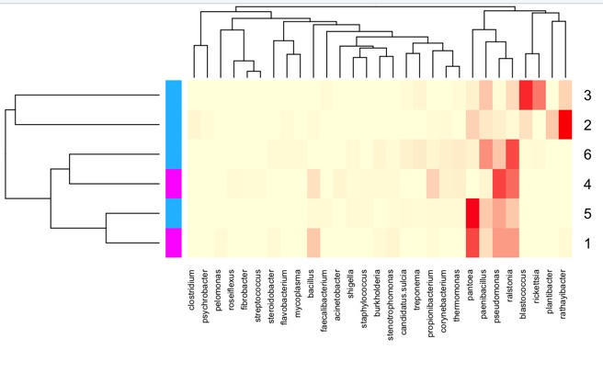
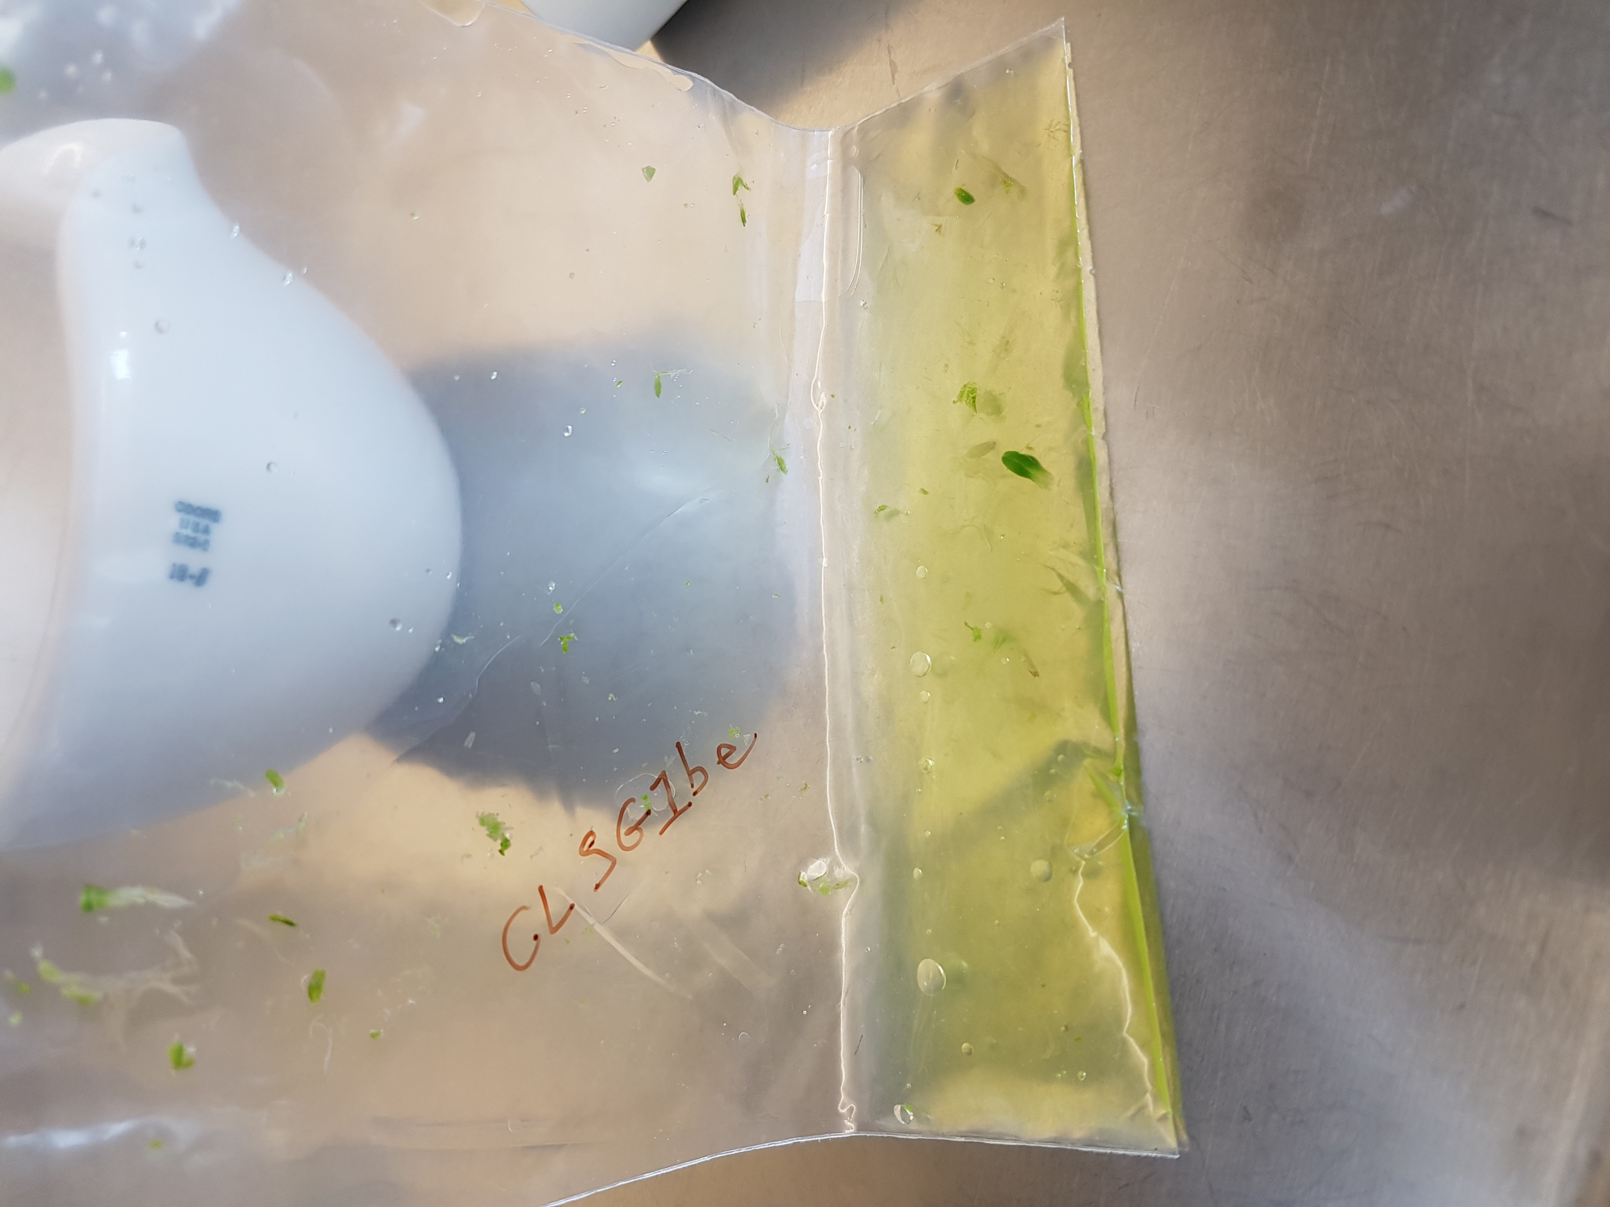
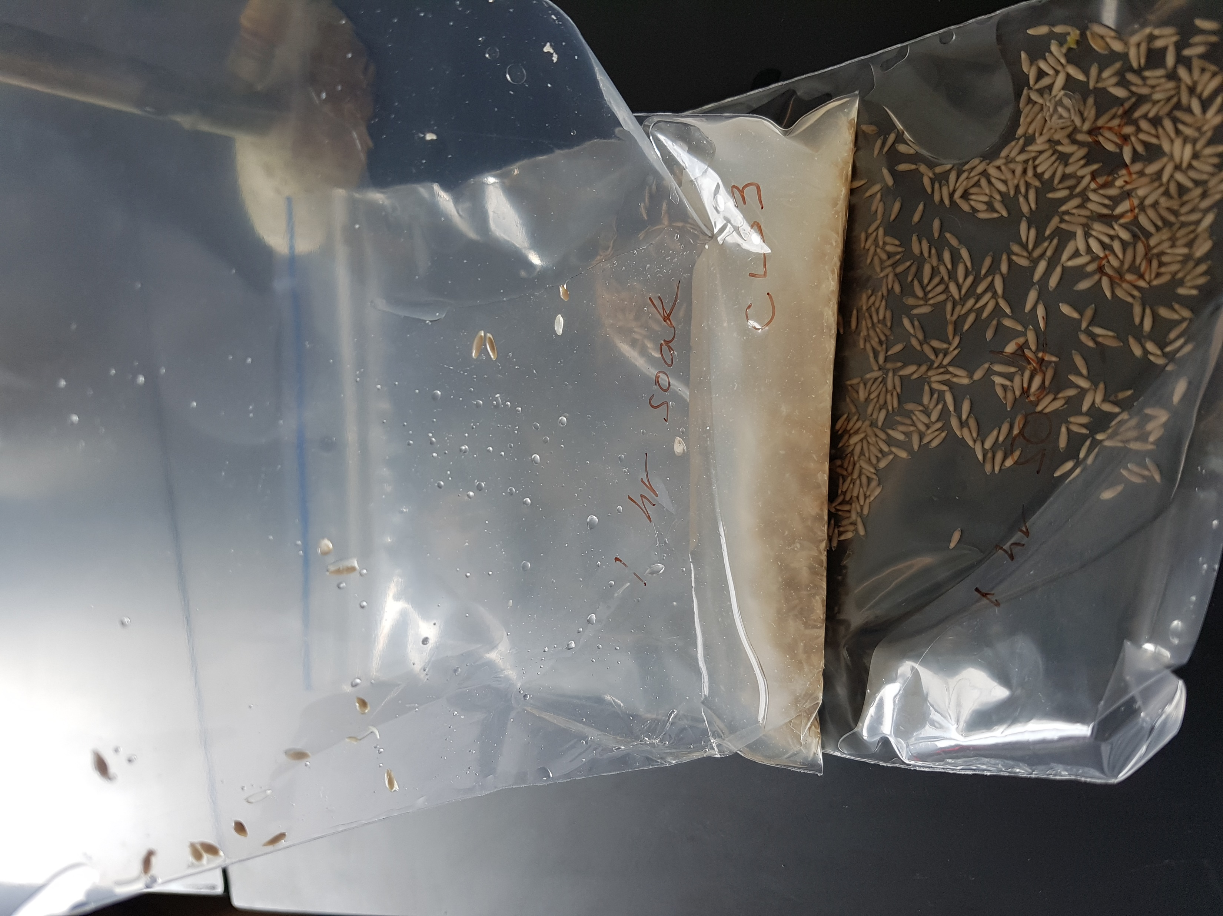
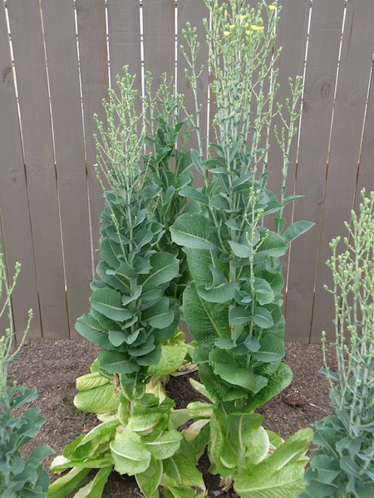
Vertical Transmission of Seed Endophytes
Areem Siddiqi, Patricia Miller, Roberta Fulthorpe
Department of Physical and Environmental Sciences
University of Toronto Scarborough, Toronto, ON, CA
Introduction
Endophytes are microbes that grow inside plant tissue, that often enhance their host’s growth, nutrient acquisition, and resistance to pests (1).
Seeds of the genus Zea (a type of maize) have been shown to vertically transmit endophytes across generations (2).
This effect has not been widely studied yet in oat or lettuce seeds to our knowledge, so we firstly sought to determine the extent of vertical transmission of seed endophytes from the first generation to third generation seeds and seedlings.
Since dry seeds are naturally dormant, it was observed in romaine lettuce seeds that seedlings grown in sterile conditions expressed additional seed endophytes that do not appear in dry seed illumina data likely due to extremely low concentrations during dormancy (3).
Therefore, we also sought to assess the differences and similarities between seed and seedling microbiomes so the data could be combined to represent all seed microbiota.
By combining dry seed and germinated seeds (seedling) samples of oat and lettuce seeds across three generations of organic and conventional cultivars, we hope to create a complete picture of the seed endophytes that are vertically transmitted.
Results
Fig. 3: Pie charts comparing seed microbiota (left) to seedling microbiota (right).
Leaf2
Seed1
Seed2
Seedling2
Leaf1
Seedling1
Methods
Surface- sterilized
Germinated seedlings
SEED
Fig. 4: 16S (Bacteria) illumina data. The heatmap shows the core microbiome. 1 represents conventional seeds and 2 represents organic seeds.
Crushed seedlings
Discussion
Combining seed and seedling data is advantageous and necessary for understanding vertical transmission of endophytes in all plants (Fig. 5).
Crushed seeds
DNA extraction + 16S illumina sequencing
Host/Parent
Whole seed Microbiome (WSM)
(Grown in sterile conditions)
Vertical Transmission
Crushed plant tissues
Data analysis
Imbibing Seed
Germination
Seedling
Fully grown plant
Fig. 1: Flowchart of methods used.
Fig. 5: Schematic demonstrating how endophytes from the seed are better expressed in a germinated seedling.
Results
Seedlings do provide additional information about the core microbiome of the seed due to the dormancy effect.
Based on previous studies that have found vertical transmission of endophytes in rice seeds (4), radish seeds (5), and maize seeds (6), we expect to see this pattern in oat and lettuce seeds.
Identifying vertically transmitted seeds can provide insight into plant-growth promoting bacteria (PGPB).
These could be used to inoculate seeds of different species to boost agricultural output (7).
Due how long it takes to grow multiple generations of plants, we do not yet have data comparing the microbiomes across generations.
Preliminary data:
 | Seeds | Seedlings | Leaf
Seeds | 95 | 137 | 73
Seedlings | 137 | 117 | 88
Leaf | 73 | 88 | 104
Seed
95
Leaf
104
Seedling
117
137
73
68
Table 1: Number of genus found in illumina sequencing data per tissue type. Numbers represent presence of genus in at least one tissue sample.
88
References
Fig. 2: Venn diagram displaying results from Table 1.
Please scan the following QR code for a list of reference used in this poster.

